Slide 1
Multi-Dimensional Arrays
Random Numbers
CSC 101 – Introduction to Computer Science
Lecture 11
Department of
Computer Science and Engineering,
Independent University, Bangladesh

Slide 2
Today
Two Dimensional Arrays
Three of More Dimensional Arrays
Random Number Generation

Slide 3
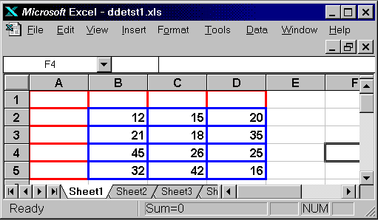
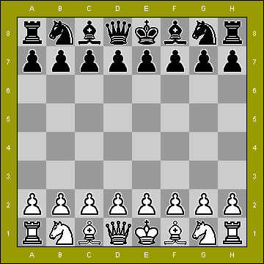
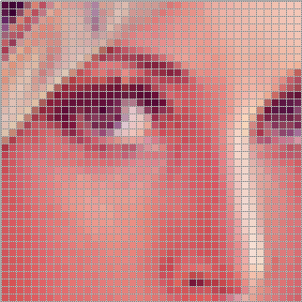
Two-Dimensional Arrays
For many programs need to represent a grid
  Math and Scientific Computing
    Spreadsheet
    Matrix computation
  Games
    Tic-Tac-Toe
    Chess
  Graphics
    Image data
    Representing the display
Could represent a grid using sets of arrays
Much more convenient to use 2D arrays

Slide 4
Declaring 2D Arrays
Use two size declarators
  const int ROWS = 4;
  const int COLS = 3;
  int exams[ROWS][COLS];
First declarator is number of rows; second is number of columns
Like 1D arrays, want size declarators to be named constants

Slide 5
2D Array Representation
const int ROWS = 4;
const int COLS = 3;
int exams[ROWS][COLS];
Accessing values
  Use two subscripts to access element
  exams[2][2] = 86;
columns
exams[0][0] | exams[0][1] | exams[0][2]
exams[1][0] | exams[1][1] | exams[1][2]
exams[2][0] | exams[2][1] | exams[2][2]
exams[3][0] | exams[3][1] | exams[3][2]
rows

Slide 6
2D Array Examples
Initialization
Display
Summing and Averaging
  summing rows
  summing columns
demo

Slide 7
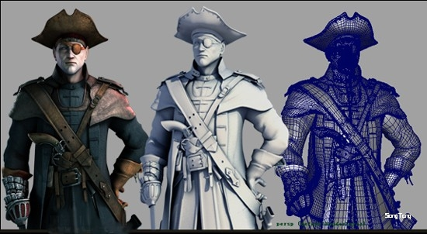
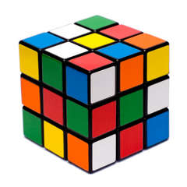
Arrays with Three or More Dimensions
Can define arrays with any number of dimensions
  short rectSolid[2][3][5];
  double timeGrid[3][4][3][4];
Graphics
  CGI
  Animated movies
Games
  FPS Games
  Rubik’s cube
Scientific computing
  Meteorology

Slide 8
Random Numbers
For many programs we need to be able to generate random numbers
Mostly in games
  Shuffle a deck of cards
  Set up a Sudoku board
  Scramble a Rubik’s cube or a slide puzzle
  Create different scenarios in FPS type games
  Set up the boxes in Deal or No Deal
Also in simulations and scientific experimentation

Slide 9
Random Number Generator
C++ provides an easy way to generate random numbers
To use the random number generator in C++ we need call the rand() function
    int foo;
    foo = rand();
To use the rand() function we also need to include the cstdlib header file
#include<cstdlib>
demo

Slide 10
Random Numbers in a Range
Typically we want to generate numbers within a certain range
  For shuffling cards
    a random number between 0 and 51
  For deal or no deal
    a random number between 1 and 26
To do this, use the modulus (%) operator
      cardPosition = rand() % 52;
      boxLocation = (rand() % 26) + 1;

Slide 11
Seeding rand()
Since computers cannot generate “truly” random numbers, the rand() function will generate the same set of random numbers every time you run the program
To avoid this situation use the srand() function to seed the random number generator with a different value for every execution
      int randseed;
      cin >> randseed;
      srand(randseed);

Slide 12
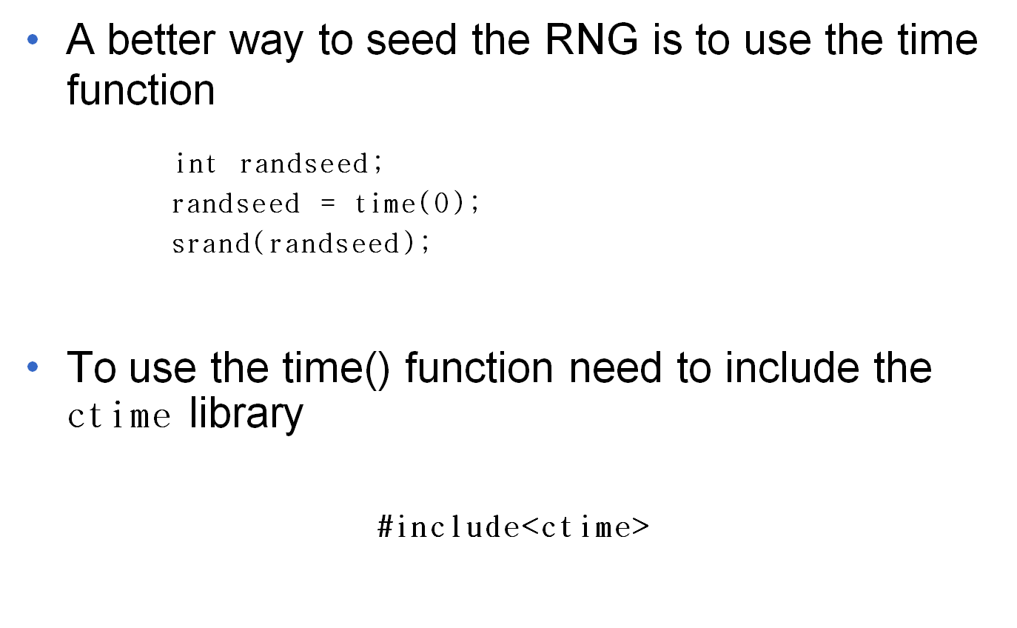
Seeding rand()

